Slide 1
Interim Presentation
12th of December 2016
A Comparison of Features Learned on
Natural vs. Drawn Image Datasets
Wang Biyuan

Slide 2
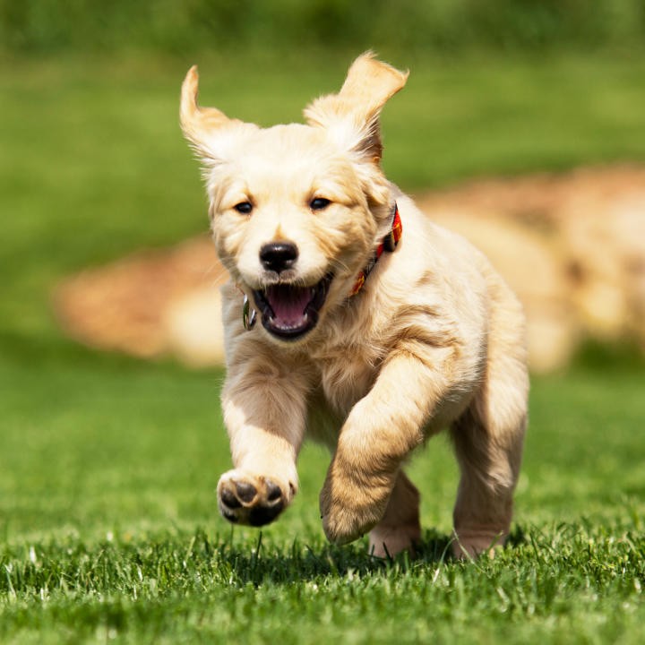
Introduction
Convolutional Neural Network has prominent performance in image understanding tasks, eg. Visual classification.
However, our understanding of image representations has been limited to natural images so far.
Dog
CNN model
Notes:
In the past few years, there are quite amount of researches have shown that convolutional network can deliver outstanding performance on visual classification tasks. However there is still not enough insight into the internal operation of these models as well as how and what they actually learn in order to perform these tasks.
2

Slide 3
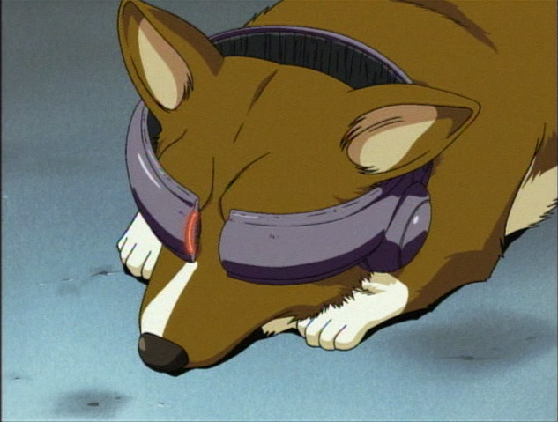
Introduction
Invert the outputs of layers back to pixel space to visualise the learning results.
Compare the features learned by networks of similar architecture but trained by two types of data of great contrasts in style.
CNN
model 1
Visualisation
Natural Features
Feature Comparison
CNN
model 2
Visualisation
Illustration
Features
Notes:
Therefore the implementation of visualisation techniques become very important in terms of making the behaviour of a deep CNN model human-comprehensible. My project is to study the features learned by different layers of the network and visualise them, also to compare the differences between features learned on natural images and illustrations. The results obtained from the visualisation are expected to help people explore more details about the deep CNN model in image recognition and therefore to design more efficient network to perform related tasks.
3

Slide 4


Preparation Work
Lectures
Practicals
Learning Lua and the tensor library
Linear regression
Classification on MNIST data and tuning of optimizers
Feedforward neural networks and completed a rectified linear unit (ReLU)
Notes:
In order to learn about the essential background knowledge, I went through the related contents in Stanford Andrew Ng’s machine learning open course and Oxford machine learning course given by Nando de Freitas. Andrew’s lectures helped me perceive the basic concepts and ideas of machine learning, while Nando’s lectures and the practicals along with the course gave me elaboration of deep learning, more focused on the mathematical concepts and the implementation of models.
4

Slide 5
Literature Review
Mahendran A, Vedaldi A. Visualizing deep convolutional neural networks using natural pre-images[J]. International Journal of Computer Vision, 2016: 1-23.
Three visualisation methods:
- Inversion: find pre-images of an image → reconstruction →
loss function to access reconstruction quality
- Activation maximization & Caricaturization: define scoring function for a certain class → visualise the representation which the response is maximized
Notes:
In my lit review, the 1st paper by Vedaldi’s group pointed out that due to most image processing methods are based on suitable image representations rather than image itself, we are still lack of understanding of these representations/features. They proposed three types of visualizations under the natural pre-images framework to explore the interpretation of representations. (natural pre-images is the notable representations in natural-looking images). In the experiments, they tuned the regularizers and optimization algorithms to investigate the effects on each layer induced by different parameters.
--inversion P10 5.1st para
--activated the most: has higher output from the scoring function, which is a scalar
5

Slide 6
Literature Review
Mahendran A, Vedaldi A. Understanding deep image representations by inverting them[C]//2015 IEEE conference on computer vision and pattern recognition (CVPR). IEEE, 2015: 5188-5196.
Direct analysis of representations by charaterising the image information they retain.
Reconstruction a number of possible samples to explore the invariances captured by the representation.
Evaluation on different regularization penalties as natural image priors.
Notes:
Because not all pre-images are useful for visualization, therefore they proposed to do the reconstruction by restricting pre-images to the set of natural images. In their earlier paper, This is achieved by using different regularizers as natural image priors to make sure the reconstructions have the same statistics as target images.
6

Slide 7
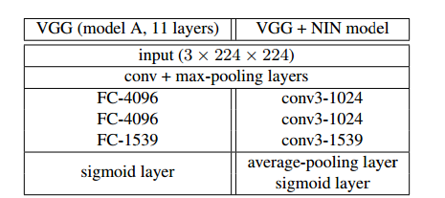
Literature Review
Saito M, Matsui Y. Illustration2Vec: a semantic vector representation of illustrations[C]//SIGGRAPH Asia 2015 Technical Briefs. ACM, 2015: 5.
Notes:
This is a paper about networks trained by illu, the authors trained a CNNs model to extract attributes of a single illustration, and mapped them to a semantic vector space . Therefore, people are able to search images with similar features. This CNNs model is different from others because It is supposed to predict multiple tags in a single image, which means more capable of precisely estimating local information. It is modified from a VGG model but replaced the fc layers by conv layers in order to get more local details.
7

Slide 8
Literature Review
Zeiler M D, Fergus R. Visualizing and understanding convolutional networks[C]//European Conference on Computer Vision. Springer International Publishing, 2014: 818-833.
Gatys L A, Ecker A S, Bethge M. A neural algorithm of artistic style[J]. arXiv preprint arXiv:1508.06576, 2015.
Gatys L A, Ecker A S, Bethge M, et al. Controlling Perceptual Factors in Neural Style Transfer[J]. arXiv preprint arXiv:1611.07865, 2016.
Notes:
1st : studied the configuration of large conv network models and general visualization techniques to understand the architectures and intermediate layer operations mentioned in the previous papers.
2nd : related to future work, which is about the style transfer. Because they mentioned that a pre-image is found simultaneously reproducing features and statics of content and style images. Such a technique can be used to generate very different images that share common deep feature representation, which could help the understanding of the invariance properties of the representations
8

Slide 9
Current Implementation
Load Caffe model VGG_CNN_S
Preprocessing of input images:
Crop image to 224x224x3 (Length x Width x Colour channel)
Rescale the smallest side to 256 (preserving the aspect ratio)
Change colour channel from RGB --> BGR
Rescale to 0-255 and subtract BGR image mean
Create class label text file (1,000 classes)
Notes:
My current implementation is focusing on the two Vedaldi’s and the illustration papers. First of all, I tried to load the VGG model. My work would be under Torch7, which is a scientific computing framework with wide support for machine learning algorithms. In order to implement the visualization methods proposed in the papers, I also chose to start with VGG models. VGG models are constructed in Caffe framework, but can be loaded and work in Torch as well. There are some requirements on the input. So 4 steps of preprocessing was done before the implementation. The model is trained on 224x224 centre crops sampled from images, rescaled so that the smallest side is 256 (preserving the aspect ratio). The released mean BGR image should be subtracted from 224x224 crops. Finally rescale pixel from 0-1 (in torch) to 0-255 (required by VGG)
9

Slide 10
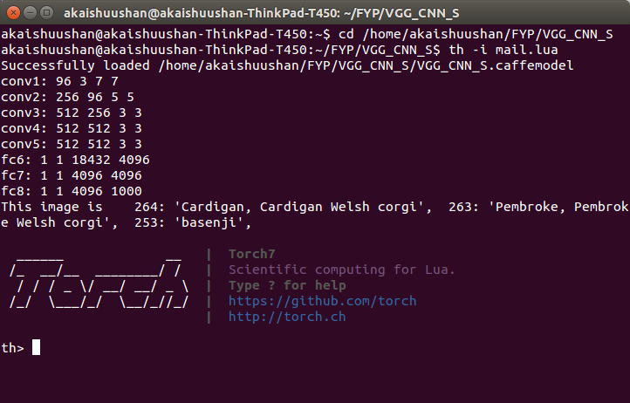
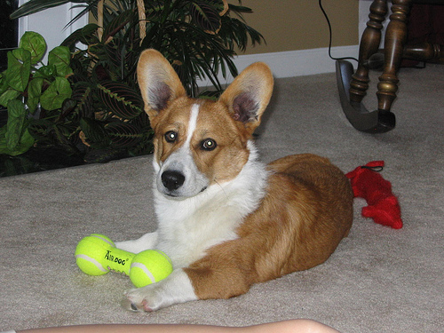
Current Implementation
Result of implementing Caffe model VGG_CNN_S
Notes:
The output of the model is a tensor that contained predicted log probabilities for all the classes. I found the indices of the highest three probabilities and mapped them back to the class label file and print the results out as shown in the screenshot.
10

Slide 11
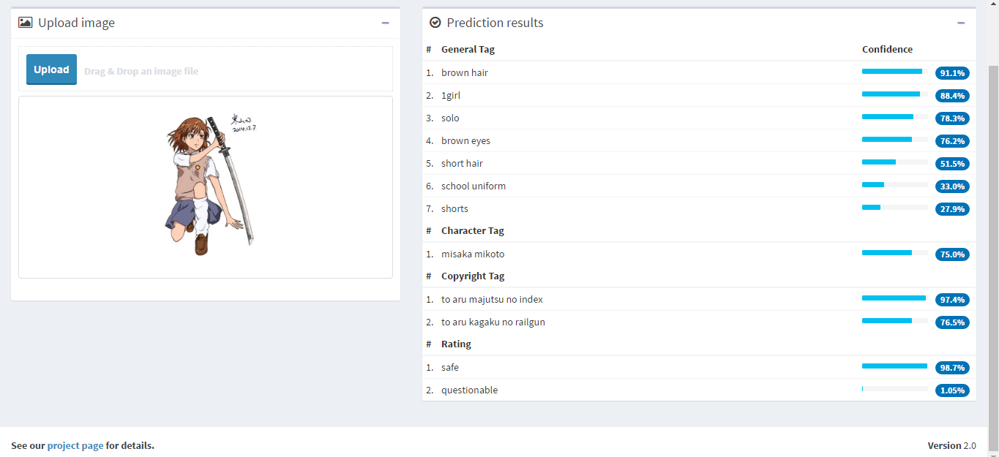
Test on illustraion2vec model demo
Result of implementing Caffe model VGG_CNN_S
Notes:
This is a test of the illu2vec demo, which is from the 3rd paper in my lit review. I tested one of my illustrations on illustration2vec model demo and it predicted fairly accurate tags on the sketch. It is notable that the model gave a preceise prediction tag of school uniforms, which could be a widely various element in illustrations.
11

Slide 12
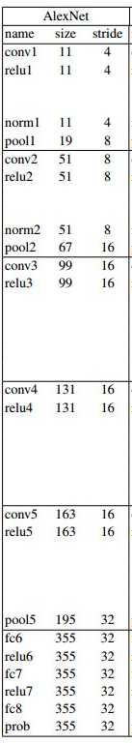
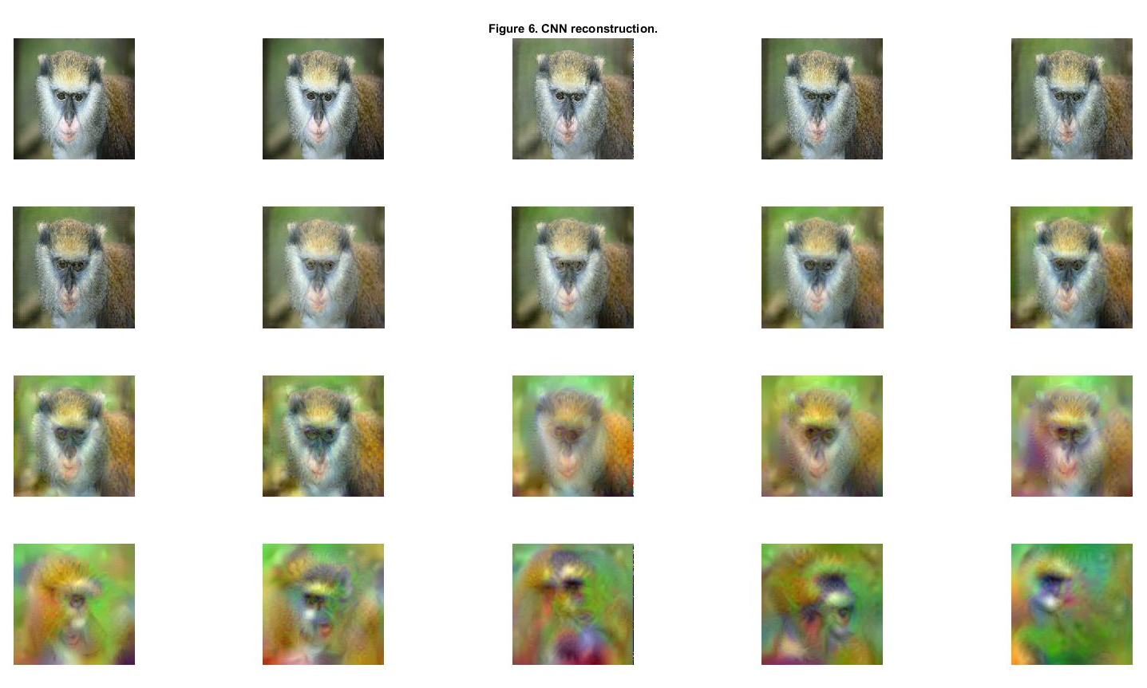
Visualisation of layers in VGG_AlexNet model
Notes:
I am currently retrieving the reconstruction from Vedaldi’s paper’s code, which they did in MATLAB by using matconvnet and vlfeat packages. From the reconstructions we can see that each layer of CNN captured different types of structure in images, from instance-specific information to large variations in layouts.
12

Slide 13
Future Work Plan
To associate with elementary feature visualisations and Vedaldi’s paper’s code to realise the reconstruction in Torch.
To implement visualisations based on natural pre-images on the VGG model.
To apply the same visualisations on the model trained by illustrations and compare the differences between the features learned by these two models
For further augment to work on style transfer.

Slide 14
Reference
Machine Learning - Stanford University | Coursera. (2016). Coursera. Retrieved 10 December 2016, from https://www.coursera.org/learn/machine-learning
Machine Learning. (2016). Cs.ox.ac.uk. Retrieved 10 December 2016, from https://www.cs.ox.ac.uk/people/nando.defreitas/machinelearning/
Mahendran A, Vedaldi A. Visualizing deep convolutional neural networks using natural pre-images[J]. International Journal of Computer Vision, 2016: 1-23.
Mahendran A, Vedaldi A. Understanding deep image representations by inverting them[C]//2015 IEEE conference on computer vision and pattern recognition (CVPR). IEEE, 2015: 5188-5196.
Saito M, Matsui Y. Illustration2Vec: a semantic vector representation of illustrations[C]//SIGGRAPH Asia 2015 Technical Briefs. ACM, 2015: 5.
Gatys L A, Ecker A S, Bethge M, et al. Controlling Perceptual Factors in Neural Style Transfer[J]. arXiv preprint arXiv:1611.07865, 2016.
Gatys L A, Ecker A S, Bethge M. A neural algorithm of artistic style[J]. arXiv preprint arXiv:1508.06576, 2015.
Zeiler M D, Fergus R. Visualizing and understanding convolutional networks[C]//European Conference on Computer Vision. Springer International Publishing, 2014: 818-833.
Notes:
14

Slide 15
Thank you

